Slide 1
MOCKITO
GRAFANA
ZEPHYR

Slide 2
MOCKITO

Slide 3
What is MOCKITO?
Mockito is an open source Java-based mocking framework used for unit testing of Java application.
It is used to create simple and basic test API’s for performing unit testing of java applications
The main purpose of using the Mockito is to simplify the development of a test by mocking external dependencies and use them in the test code.
As a result, it provides a simpler test code that is easier to read, understand, and modify.
We can also use Mockito with JUnit and TestNG.

Slide 4
Comparison between Selenium and Mockito
SELENIUM
MOCKITO
Selenium automates browsers. Primarily, it is for automating web applications for testing purposes.
It will do Browser testing, Automated testing, Website testing, Load and Performance testing
Mocking framework for unit tests in Java
It will do simple and basic test

Slide 5

Benefits of Mockito

Slide 6
Mockito Environment Setup
Step 1 − Verify Java Installation on Your Machine (Open Command Console c:\> java -version)
If you do not have Java installed, To install the Java Software Development Kit (SDK) click here.
Step 2 − Set JAVA Environment
Set the environment variable JAVA_HOME to C:\Program Files\Java\jdk1.6.0_21
Append the location of the Java compiler to your System Path
Append the string ;C:\Program Files\Java\jdk1.6.0_21\bin to the end of the system variable, Path.
Verify Java Installation using the command java -version as explained above.
Step 3 − Download Mockito-All Archive
To download the latest version of Mockito from Maven Repository click here.
Step 4 − Set Mockito Environment
Set the environment variable Mockito_HOME to C:\Mockito
Step 5 − Set CLASSPATH Variable
Set the environment variable CLASSPATH to %CLASSPATH%;%Mockito_HOME%\mockito-all-2.0.2-beta.jar;.;

Slide 7
Mockito Environment Setup
Step 6 − Download JUnit Archive
Download the latest version of JUnit jar file from Github.
Save the folder at the location C:\>Junit.
Step 7 − Set JUnit Environment
Set the JUNIT_HOME environment variable to point to the base directory location where JUnit jars are stored on your machine.
Set the environment variable JUNIT_HOME to C:\JUNIT
Step 8 − Set CLASSPATH Variable
Set the CLASSPATH environment variable to point to the JUNIT jar location.
Set the environment variable CLASSPATH to %CLASSPATH%;%JUNIT_HOME%\junit4.11.jar;%JUNIT_HOME%\hamcrest-core-1.2.1.jar;.;

Slide 8
GRAFANA

Slide 9
What is Grafana?
Grafana is open source visualization and analytics software.
It enables us to create a dashboard for collecting, processing, storing, and analyzing data from various different sources.
It will provide charts graphs and alert for the web
It will process the large amount of data and monitor
It allows you to query, visualize, alert on, and explore your metrics, logs, and traces no matter where they are stored.
It provides you with tools to turn your time-series database data into insightful graphs and visualizations.
It help us to track the user behavior, application behavior, freaquency and types of error and contextual scenarios by providing relative data

Slide 10
How to setup Grafana
Download the installer and run it.
http://localhost:3000 port will open grafana
By deafult Username: admin & Password : admin
Click the + icon on the side menu.
On the dashboard, click Add an empty panel.
In the New dashboard/Edit panel view, go to the Query tab.
Configure your query by selecting -- Grafana -- from the data source selector. This generates the Random Walk dashboard.
Click the Save icon in the top right corner of your screen to save the dashboard.
Add a descriptive name, and then click Save.
This is the first dashboard and you can see the result

Slide 11
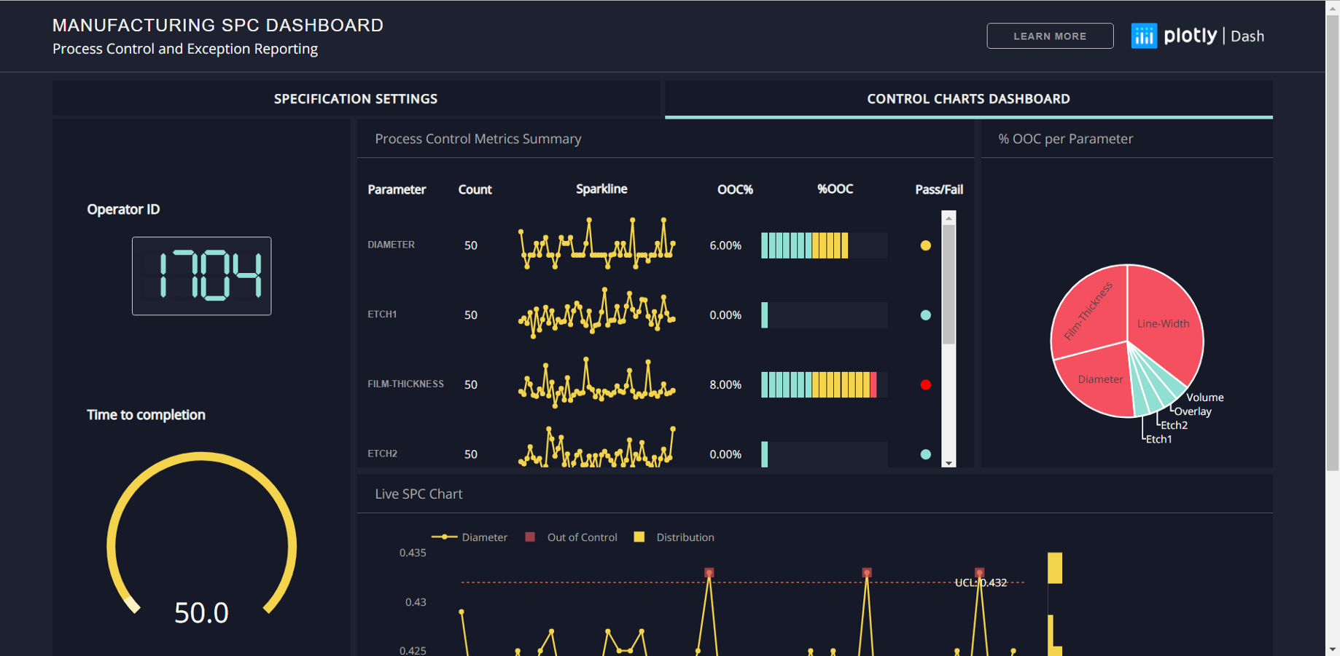
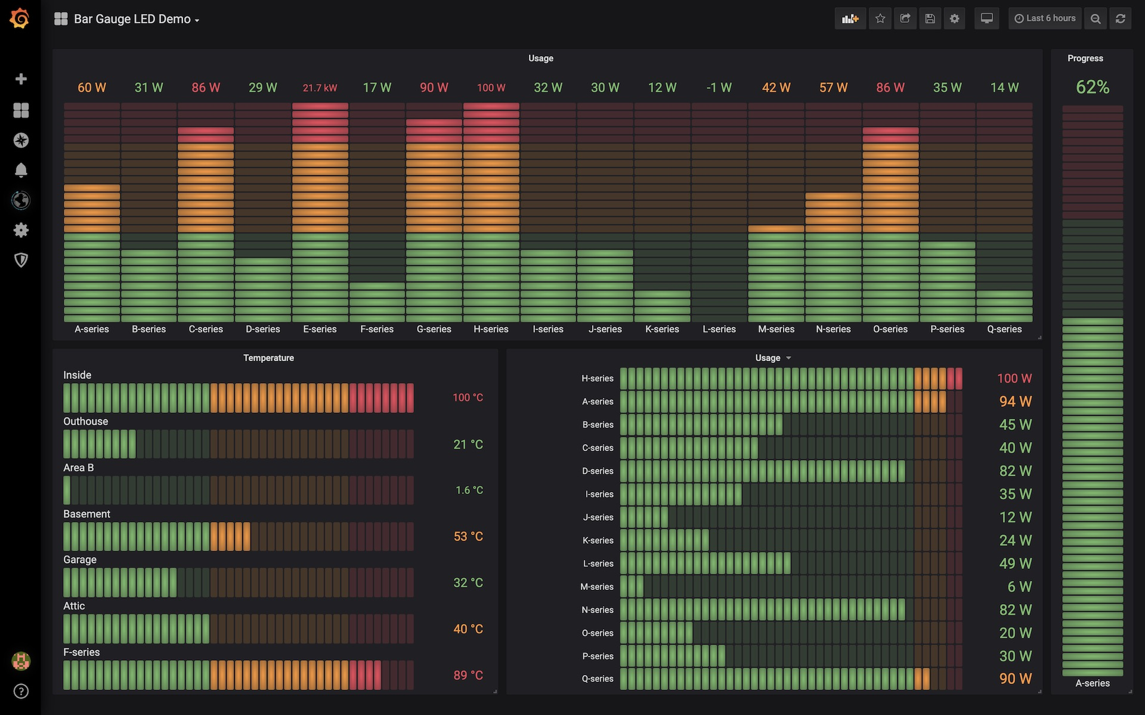
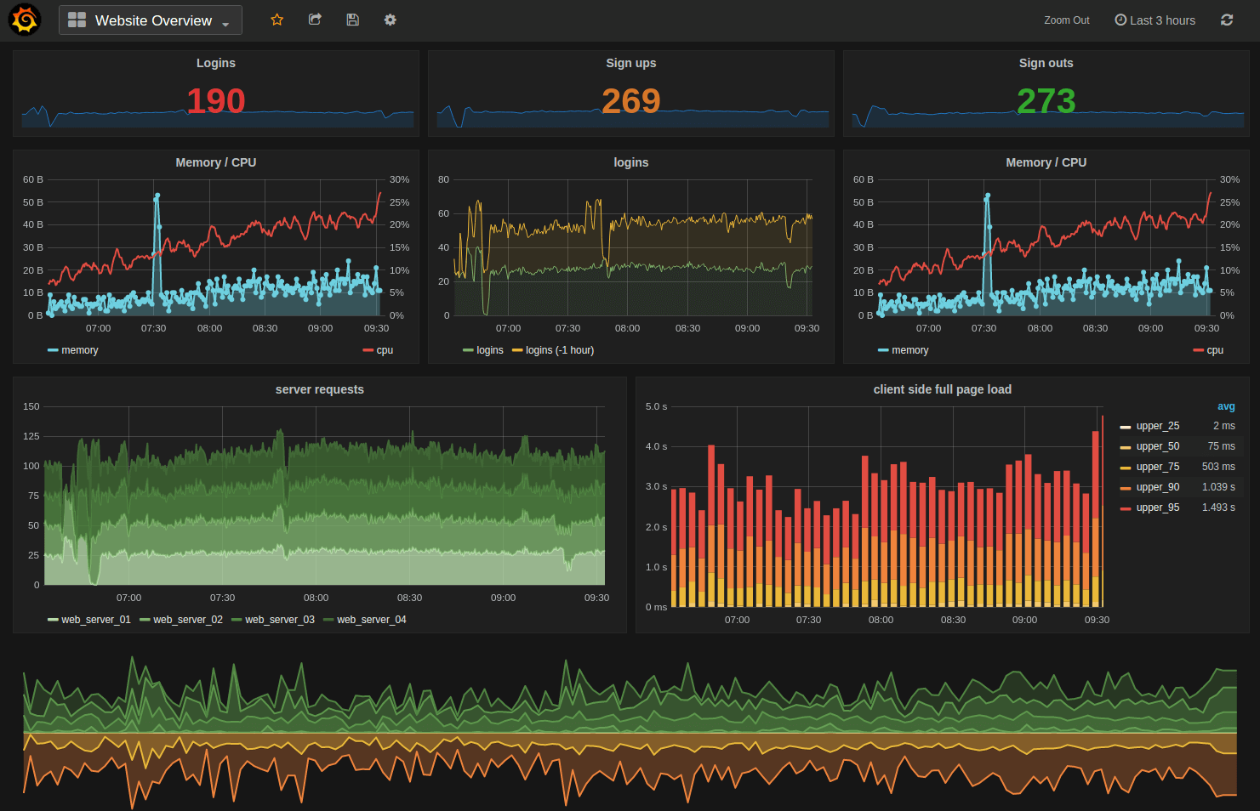
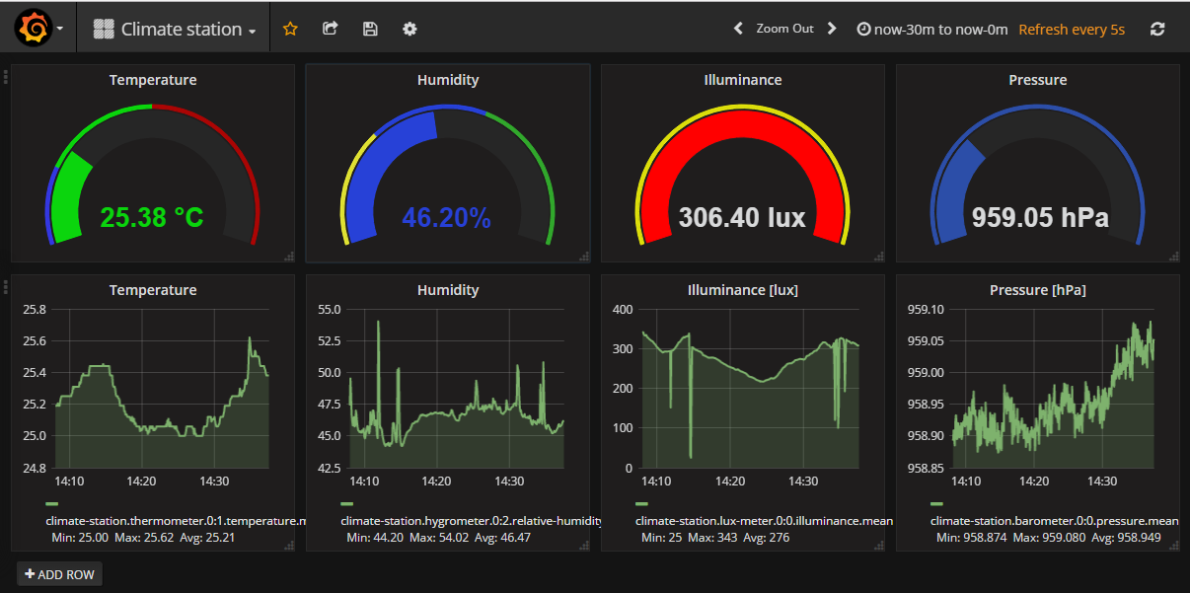
Visualization in Grafana

Slide 12
Features of Grafana
With the help of dashboards, data is presented in an informative, efficient, and presentable manner.
Grafana makes the users know the data well.
The dashboards in Grafana can be shared with the team members.
It is a platform for sharing appears to be helpful to save time for the team members to analyze the charts
The dynamic templates with the dashboards help to integrate with other systems and to provide alerts if needed
The logs can be created so that data can be tracked easily if any backlogs happen.

Slide 13
ZEPHYR

Slide 14
What is Zephyr
Zephyr is a testing solution that improves the quality of your software by managing and monitoring end-to-end testing.
Zephyr for Jira
Zephyr for jira enables us to manage our test directly in Jira
Testing is incorporated into the project cycles and it permits you to track software quality and make empowered decisions.
Create, Plan, and Execute Tests
Create, view, and modify test steps.
Build test execution cycles.
Execute the tests and link defects to specific tests.
Track Quality of the test cases
It provides a simple dashboard that consists of testing metrics on the testing activities throughout every project.

Slide 15
Setup of zephyr inside Jira
Installation:
Sign up - Try Atlassian Cloud | Atlassian
Install JIRA and inside JIRA look for Apps and search for Zephyr for JIRA to be plugged in
We can add Test items as tickets to your Jira projects, link them to other Jira issues, plan your testing efforts by using test cycles, and track your testing efforts via metrics and reports.

Slide 16
Setup of zephyr inside Jira
Zephyr simplifies the testing process as test cases are organized under Jira tickets.
A user typically adds a test case by setting the ticket type to ‘Test’.
Once the ticket test is added with the appropriate title, description, and other relevant information, the user has the opportunity to update Actions, Details, and Execution.
Users can execute an added test case or add to the test cycle directly from the test case.
In ‘Details,’ users have the ability to edit/update the test steps. ‘Execute’ will display all the past executions related to the test case.

